Slide 1
Flask Coherence A Morphable Hybrid Coherence Protocol to Balance Energy, Performance and Scalability
Lucía G. Menezo
Valentín Puente
Jose Ángel Gregorio

Slide 2
Motivation
Complex on-chip cache hierarchies in CMPs
To maintain coherence (and programmers ☺):
Hardware mechanism → coherence protocol
What type of protocol should be used?
Not universal solution
Trade-offs in costs, energy and performance

Slide 3
Pure coherence: directory-based
Structure with all the coherence information
Demands directory inclusivity
Duplicate-tag inefficient with large num of cores due to associativity
To meet energy constraints: overprovision the directory capacity to minimize evictions in private caches
Private cache sizes growing → number of tracked blocks also grows

Slide 4
Pure coherence : broadcast-based
Miss in private caches → broadcast request
Better resource utilization: neither inclusivity nor additional structures to track block copies are required
++ traffic and cache snoops → -- energy efficiency
Traffic impact in medium/large-scale noticeable or possibly unsustainable
Better performance although on-chip resource contention could degrade it
Notes:
Broadcast-based: miss in private caches → broadcast request
Better resource utilization: neither inclusivity nor additional structures to track block copies are required
+ traffic and cache snoops → - energy efficiency
Impact in medium/large-scale noticeable or possibly unsustainable
On-chip resource contention: degrading CMP performance

Slide 5
Hybrid coherence ?
Flask
Performance of broadcast-based
Energy efficiency of a directory-based
Structure to track:
Shared blocks precisely (actively ones)
Private blocks approximately
Broadcast after some misses in the structure
Additional features to minimize on-chip and off-chip traffic
Notes:
Flask gets the best of both worlds: performance of broadcast-based and energy efficiency of directory-based.

Slide 6
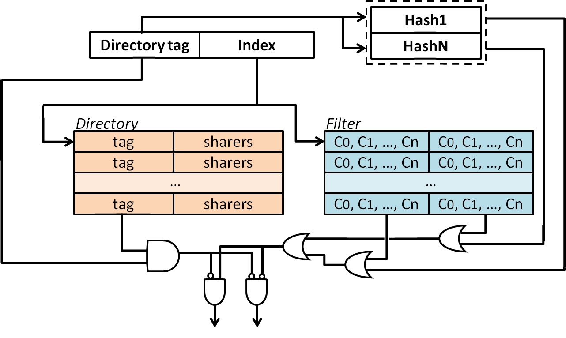
Flask Coherence Controller
Directory only tracks actively shared blocks
Filter to know (aprox.) when a block is inside the chip
Token coherence to:
To guarantee coherent invariants
To monitor when to update Flask structure
Flask Controller
Flask
Controller
LLC0
FC
FC
LLC1
FC
FC
LLCn
On-chip network
Token Coherence protocol:
Initially each block := # tokens (==#procs)
Read request: data and 1 token
Write request: data and all tokens
Private
cache
Core
Notes:
Directory: contains tags of the blocks that are being actively shared (NOT ALL OF THEM!!)
Filter: contains info of the blocks inside the chip Besides, Flask uses token coherence main characteristics to guarantee coherence invariants

Slide 7
Flask Coherence Basics
Private block
Block only in one private cache → no entry allocated in directory
Replacement will move the block to further levels until LLC
Actively shared block
A block present in any private cache is requested by another core
Need to allocate an entry in the directory
Notes:
For actively shared blocks: the allocated entry in the directory, does not have to be present all the time that the block is present in the private caches. See next slide.

Slide 8
Flask Conceptual Approach
Directory
Filter
3
Flask Coherence Controllers
Last Level Caches
V
I
sharers
--
0 1 0 0
2
2
1
Private Caches
I
S
0
1
N/A
data
O
3
data
S
1
data
I
0
N/A
P0
P1
P2
P3
4
3
Notes:
If directory has the information for a requested block, Flask works as a normal directory-based coherence protocol: forward request to the owner, the owner sends a copy to the requestor.
But if the requestor needs to replace the entry with the information because of lack of space, it can replace it without invalidating the copies of the block present in the private caches.
In that case, if a core sends a request to the directory, this one has no information about the block and needs to find it and reconstruct its sharing information (if it is shared). For doing so, it checks if the requested address is present in the filter.
If the filter says the address IS NOT inside the chip, the request is sent to memory and memory will reply with the block and all the tokens. This will be a private block so the directory will not have to allocate an entry for that block.
If the filter says that the block IS inside, the the controller checks if the data block with all the tokens is present in the LLC and if it is not, it sends a broadcast request to all the coherence agents in the system.
All the coherence agents will reply with the number of tokens they have.
This broadcast requests also includes information about the requestor of the block so that the owner can solve the pending operation during the reconstruction process (keeping it out of the critical path).

Slide 9
Reconstruction process
All coherence agents will respond with the number of tokens owned for the requested data
2 possible cases:
LLC has all the tokens
No other copy of the block in the chip
Block not actively shared: no entry allocated.
Any private cache has token
Block actively shared and entry is allocated in dir.
Non of them have any tokens
Filter gave a false positive
Notes:
CASE1: LLC has a copy of the block with all the tokens
NOTE: In this case, the broadcast reconstruction message is not sent to the private caches.
It is a private a block so no entry is allocated in the directory.
CASE2: any private cache has token
Actively shared block: entry allocated in the directory
CASE 3! no one has tokens --> Flask filter false positive (see paper for probabilities)

Slide 10
Flask Filter
d-left Counting Bloom Filters
Double efficiency of the counters of a CBF
Each filter:
attached to each directory entry
tracks all the tags that map in that entry
Combination of hash function and permutations to know which bits are modified
F. Bonomi et al. “An improved construction for counting bloom filters,” in ESA’06 14th Annual European Symposium, 2006.
Notes:
(See paper for Flask filter design details)

Slide 11
When is the Flask filter modified?
Increment filter: after an on-chip miss
Counter saturation avoidance mechanism
Decrement filter: LLC evicts block with all tokens
Flask prepared in case LLC needs to evict with not all tokens (<0.01%)
Updates are done overlapped with main memory access or after LLC replacement (outside the critical path)
Notes:
99.99% of the cases when LLC wants to replace, it has all the tokens
(See paper for Flask filter design details.)

Slide 12
Resource Partitioning
Directory and filter are “complementary”
++ actively shared blocks→ -- pressure on filter
++ private blocks → -- pressure on directory
Dynamically decide according workload characteristics
Directory
Filter
tag
sharers
tag
sharers
C0, C1, …, Cn
C0, C1, …, Cn
C0, C1, …, Cn
C0, C1, …, Cn
C0, C1, …, Cn
C0, C1, …, Cn
tag
sharers
tag
sharers
tag
sharers
C0, C1, …, Cn
C0, C1, …, Cn
C0, C1, …, Cn
C0, C1, …, Cn
C0, C1, …, Cn
C0, C1, …, Cn
tag
sharers
…
…
tag
sharers
tag
sharers
C0, C1, …, Cn
C0, C1, …, Cn
C0, C1, …, Cn
C0, C1, …, Cn
C0, C1, …, Cn
C0, C1, …, Cn
tag
sharers
Notes:
How the dleft filter works, allows to use a conventional single-ported SRAM memory.
This gives the possibility to use the same storage to keep either directory or filter information and the controller logic can route how is the distribution made according the workload characteristics.

Slide 13
Evaluation methodology
Number of cores |  | 16 @3GHz
IWin size/Issue Width |  | 196, 6-way
Block size |  | 64B
Private | L1 Size / Associativity | 32KB I/D, 4-way
 | L2 Size / Associativity | 256KB, 8-way (exclusive with L1)
L3 Shared | Size / Associativity | 16MB 16-way
 | NUCA Mapping | Static, interleaved across slices
Memory Capacity |  | 4GB
Max. Outstanding Mem. Operations |  | 64
Topology |  | 4×4 Mesh
Flask
LLC0
F
LLC1
F
LLC2
F
LLC3
R
R
R
R
$2
$2
$2
$2
$1
$1
$1
$1
C
C
C
C
F
LLC4
F
LLC5
F
LLC6
F
LLC7
R
R
R
R
$2
$2
$2
$2
$1
$1
$1
$1
C
C
C
C
F
LLC8
F
LLC9
F
LLC10
F
LLC11
R
R
R
R
$2
$2
$2
$2
$1
$1
$1
$1
C
C
C
C
F
LLC12
F
LLC13
F
LLC14
F
LLC15
R
R
R
R
$2
$2
$2
$2
$1
$1
$1
$1
C
C
C
C

Slide 14
Flask Execution Time
TokenB
Dir
Flask
(160% - 80% - 40% - 20% - 10% - 5%)
X%: space available to track X% of the private cache block tags
Dir: 160%=8K entries; 5%=32 entries
Flask: 160%=4K entries; 5%=16 entries
Notes:
To keep implementation cost constant, in Flask, storage capacity is half dedicated to the directory and half to the filter.
Sparse dir performance degrades below 1/4th of the aggregate private cache capacity
Hits in private caches are less as the number of tracked blocks is reduced → remove blocks from private caches because of lack of space in directory, while flask allows these blocks to stay in the private caches.
Sparse dir needs to get any reused blocks from LLC while Flask keeps them closer to the processor.
Consistent with sharing degree of apps
Unstable behavior of tokenB due to on-chip contention

Slide 15
Analyzing On-Chip Traffic
Adapting resources
…
5%
160%
TokenB
-- directory ++ filter
++ directory -- filter
Notes:
Broadcast traffic of both protocols, flask normalized to Tokenb.
Avoided reconstruction broadcasts shown to see filter efficiency for each directory size. Flask traffic is orange and red section.
Number of false positives increases as the directory size is reduced. As more address are mapping to the same entry in the directory, more elements each filter has to track (with the same number of bits).
If we run the same applications but deciding dynamically how the storage capacity is distributed (adapting resources), filter positives are decreased when we give less filter and more filter in apps with a lot of private blocks (multiprogrammed and numerical) and compulsory reconstructions are decreased when we give more directory and less filter in applications with high sharing degree (server).
If we check on average, we see how the traffic is reduced by half compared to a static resource assignation.

Slide 16
On-chip memory hierarchy EDP
TokenB
Flask(5%)
Sparse Dir (160%)
Notes:
All Flask benefits not at the expense of energy.

Slide 17
Conclusions and future work
Flask: re-architectures directory coherence protocols with benefits from snoop-based coherence
Improve performance and power (with extreme configurations) with no high toll
Cloud-computing scenarios
Morphing dir & filter during application execution
Multi-CMP: hierarchical coherence
Use directory+filter+token information to minimize traffic between chips

Slide 18
Thank you
Questions?

Slide 20
Sketch of a dlCBF filter
Address
Hash
Function
Permutation 1
Permutation 2
bucket₁, Remainder₁
bucket₂, Remainder₂
b₀
b₁
b₂
b₃
b₄
b₀
b₁
b₂
b₃
b₄
R₁
_{cnt}

Slide 21
Memory latency overhead
TokenB
Dir
Flask
(160% - 80% - 40% - 20% - 10% - 5%)
Off-chip requests are induce by LLC capacity misses and both protocols handle LLC the same
Numerical: false positives affect negatively due to delay in off-chip access
Commercial: extra traffic of compulsory reconstructions increases contention delaying memory access
Effect < 5% in the most adverse configuration → unnoticeable in average access time

Slide 22
Performance with different associativities
Negligible impact of directory conflicts on Flask performance:
1) No need to perform external invalidations after a directory eviction
2) Directory only tracks actively shared blocks

Slide 23
Performance with different associativities
Negligible impact of directory conflicts on Flask performance:
1) No need to perform external invalidations after a directory eviction
2) Directory only tracks actively shared blocks
Notes:
→ FT very low directory reuse

Slide 24
Mosaic vs. Flask
Flask only reconstructs shared blocks
Multi-programmed: -- traffic (increases as the filter is reduced)
Commercial: high sharing degree, compulsory reconstructions are unavoidable

